Slide 1
Increasing student engagement using Math modeling and drones in a mathematics classroom
Aziz Zahraoui
(Pronounced: Za’Ra’Wii -------------Twitter: @MrZchs)
Secondary Mathematics Teacher (Geometry/ AP Calculus)
Community College Adjunct Faculty (Quantitative Reasoning/ Pre-Calculus)
NASA MODSIM Teacher Ambassador and Math Modeling Hub Fellow
Notes:
Welcome. That is my entire background!

Slide 2
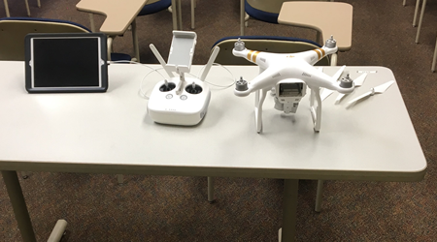
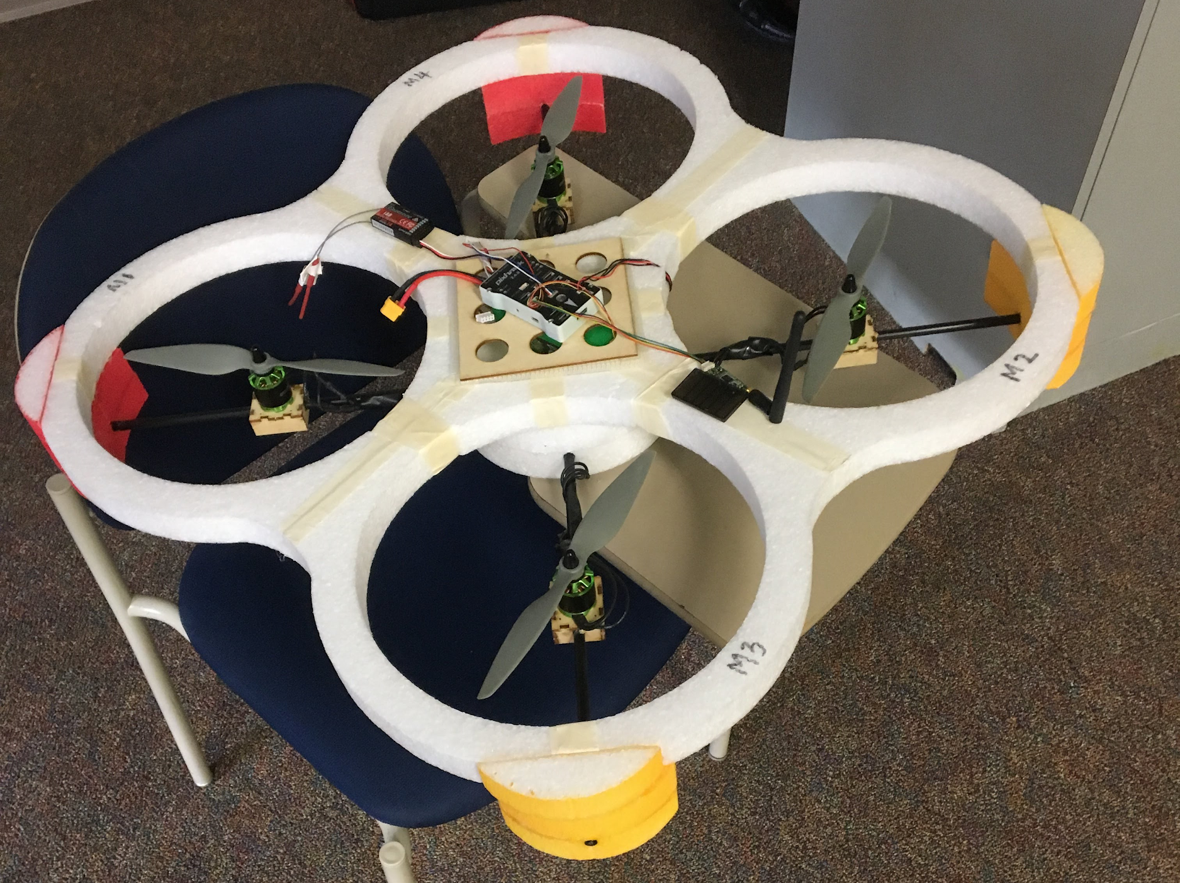
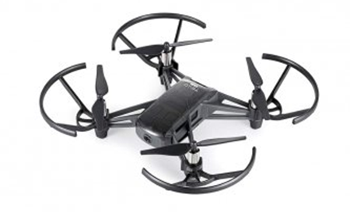
How it started

Slide 3
The Problem:
The Tello drone has 2 sensors, 1 sensor measures the acceleration of the drone, and the other sensor measures the height (altitude) of the drone. The drone provides data about 3 measurements, height, velocity, and acceleration. If the Tello drone does not have a sensor for velocity, how does it provide measurements for velocity? How can we verify that the sensors are functioning properly onboard the drone?

Slide 4
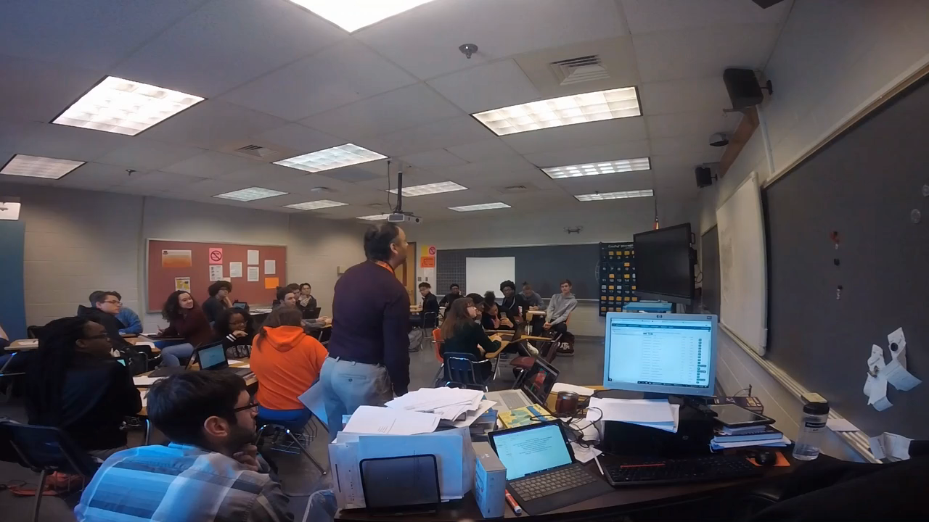
The Drone Flight in-Class 3/28/2019

Slide 5
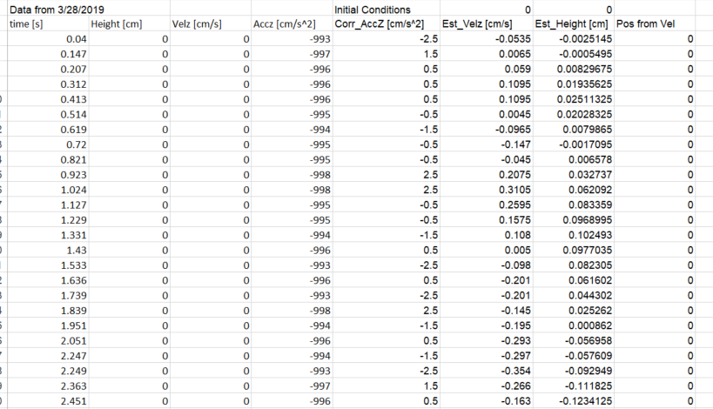
Data Collected
Notes:
There will be an Excel spread sheet of this data available for your use. What I like about this is, its raw data so many decision had to be made to clean the data. I didn’t intervene in this. It was hey you guys can do whatever you want but the students found quick that they can’t work with the data the way it is right now. They needed to clean it up.

Slide 6
Acceleration and Velocity Graphs--Real
Notes:
The blue points are data measured by the accelerometer.
The red points are an estimation of Velocity from that measured data.

Slide 7
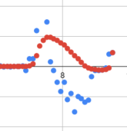
Acceleration and Velocity Graph
Notes:
The blue points are data measured by the accelerometer.
The red points are an estimation of Velocity from that measured data.

Slide 8
The height Graph-- Real
Notes:
The blue points in this Graph is measured data from the height sensor. The red points are an estimation of height from the acceleration measurements that we got in the previous Graph.
Students need to use their knowledge of Calculus to determine if the two independent sensors correlate.

Slide 9
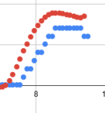
Measured Height compared to estimated height
Notes:
Blue is the real reading from the sensor. The Red is the estimate we got from double integrating Acceleration (Reimann Sum)

Slide 10
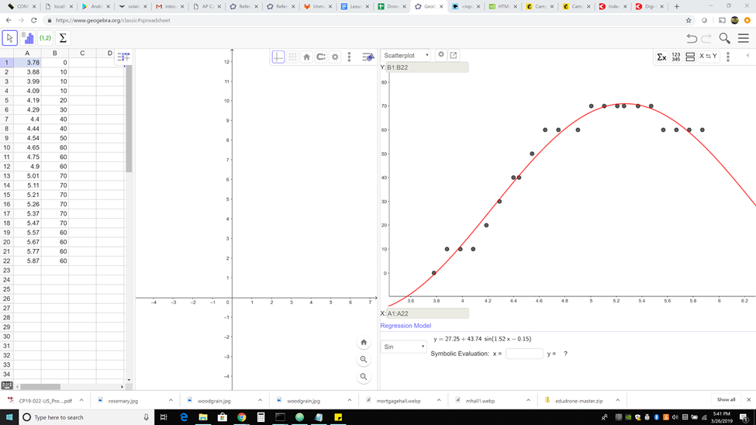
Geogebra Spreadsheet of a segment of height data vs time. This is used to estimate a continuous function that is differentiable within the time segment.

Slide 11
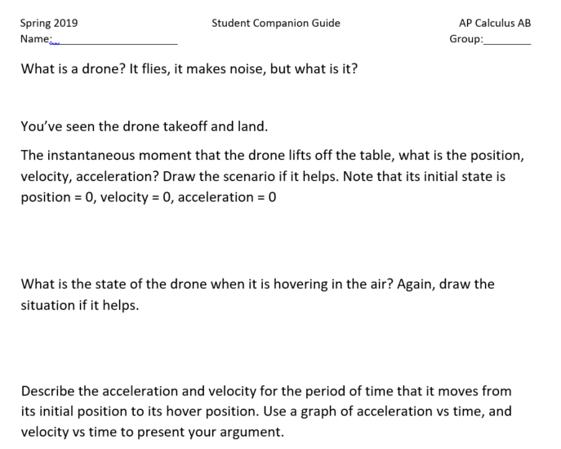
Notes:
This is the actual Student Companion Guide I used during this activity

Slide 12
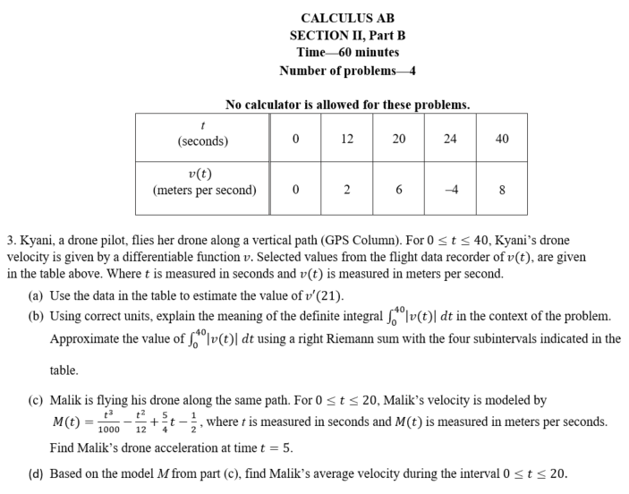
Notes:
The Pre-test is a question I have adapted from the 2015 AP Calculus AB question #3. Both Kyani and Malik are students in my Calculus class, I used the opportunity to include some Culturally responsive strategies
8 m/s = 17.89 mph
2 m/s= 4.47 mph
6 m/s= 13.42 mph
4 m/s= 8.94 mph
Drone can go between 50 to 70 mph and the race drone can go up to 87 mph

Slide 13
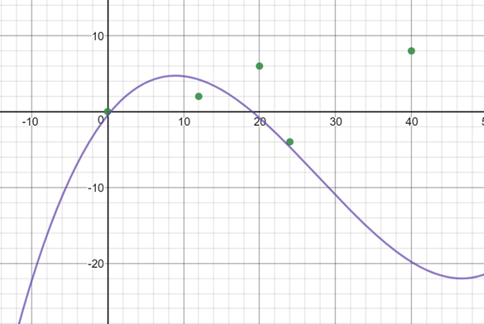
Geogebra Graph of the table of points presented in the Pre-Test and the continuous function generated as a model.

Slide 14
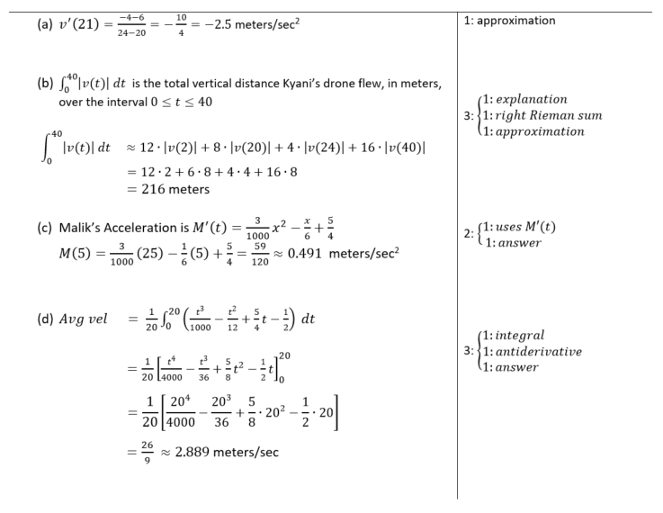
Notes:
Scoring Guide for the pre-test

Slide 15
What worked?
Bringing the drone to class was a hit with students, some asked to take short videos to post on social media. It was nice seeing the kids excited about learning in a math class.
Trying to solve a real-life engineering problem created a sense of purpose for students. A sense that they are not doing the problem as a drill, but more to solve a well-defined engineering problem.
The conversations my students were having throughout the session were on target and constructive. They did a good job activating prior knowledge and using it to solve the problem in front of them.
Notes:
This showed up on there Post-Test Performance

Slide 16



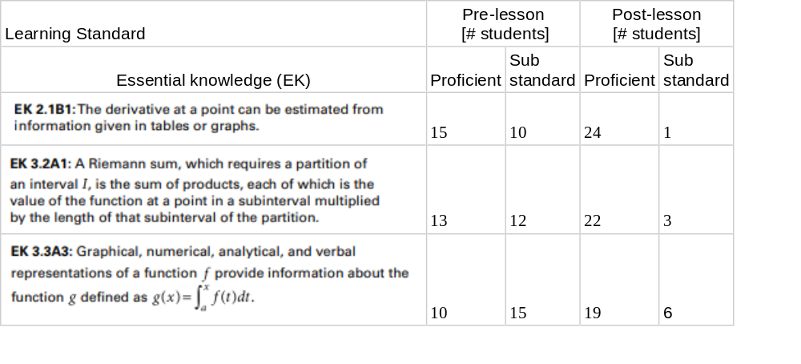
Metric Data for the drone lesson
Notes:
I used the modified version of the 2015 AP Calculus AB question#3 for the Pre-test and the actual 2015 AP Calculus AB questions #3 as the Post-test.

Slide 17
What did not work?
1) The Student Companion Guide did not do a good job. The questions were too broad, leaving me with the task of doing more to steer the students in the right direction. I needed to have used detailed questions to focus the students on the right aspects to consider. This is also where a teacher might consider modifying the activity to better fit their specific students.
2) Using google classroom to disseminate the data obtained from the drone was not done properly. I sent the data ahead of time to eliminate transition downtime. Unfortunately, some students accessed it ahead of me. I rolled with it even though it was not planned that way.
3) The graphs attached to the data did not show up the way I would have liked them to be. They were small and hard to maneuver. They could still serve the purpose. A better idea would have been to take the data and have the students feed it to Geogebra, this would have extended the scope of the lesson beyond what I wanted. Nonetheless, moving forward, that is what I will do. I would also use this to circumvent any technical issues. I would fly the drone, and then use data from a similar flight that I have saved. Collecting data instantly can be a technical and pedagogical nightmare.
Notes:
This is the reason why I mention in the description of this webinar that owning a drone in not necessary although it is preferable for the cool effect. Bureaucracy!! IT issues!! The more I tried to improve it the more outside issues I ran into. There is a software that you can use to collect data from moving object in a recording.

Slide 18
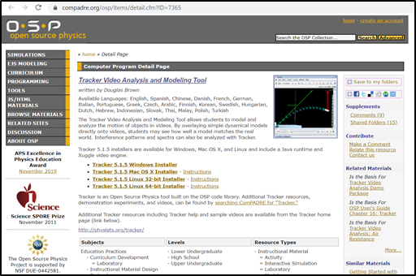

What to do if you do not have a drone?

Slide 19
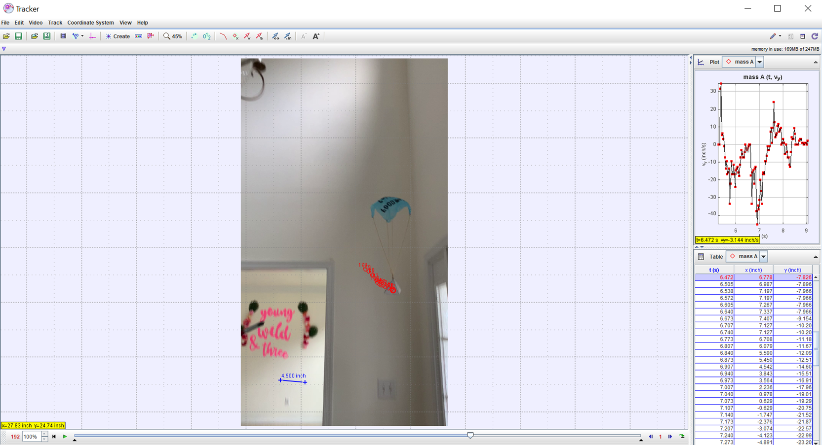
The Tracker
Notes:
This is an unrelated experiment I conducted using a parachute.

Slide 20
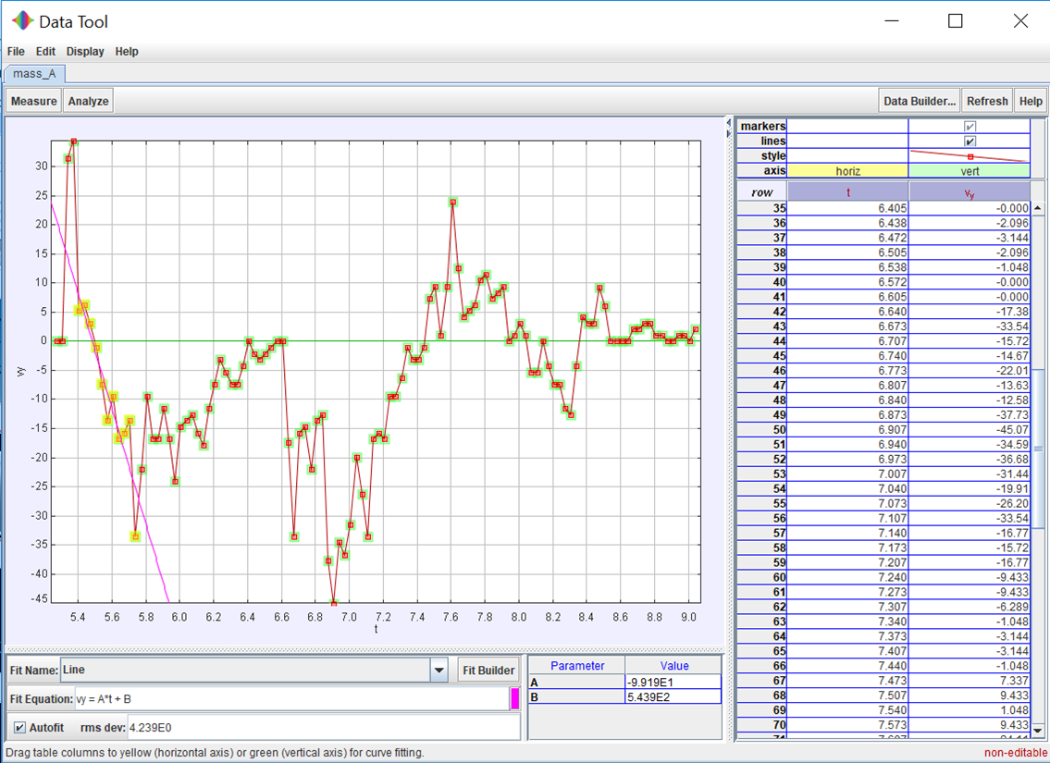
The Tracker
Notes:
The data analyzer allows you to fit different types of models to the data you have.

Slide 21

Questions?
Email: Aziz.zahraoui@portsk12.com
@MrZchs

